Slide 1
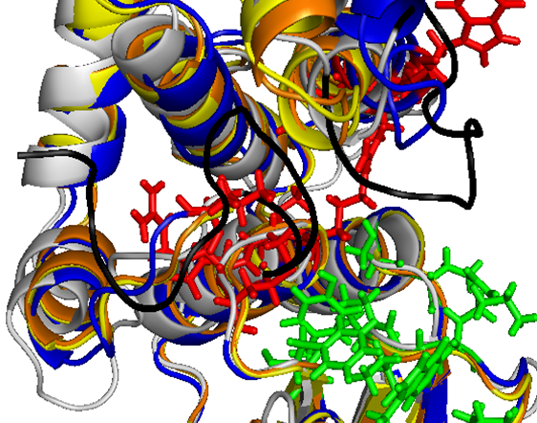
B
A
A
B
N-Term
Suppl Fig. S1
Notes:
Supplementary Fig. S1. Tertiary structures of Clonorchis sinensis sigma-class GSTs. The 3-dimensional structures of CsPGDS1 (yellow) and CsGST-σ3 (orange) were simulated using I-TASSER, and their ribbon models were aligned together with that of human HPGDS (blue) using PyMol. CsGST-μ1 structure (gray) was also included in the alignment. The side chains of amino acids comprising the GSH- and PGH₂-binding sites are marked in green and red, respectively. A and B mark the amono acid stretches uniquely observed in CsGST-μ1 (see Fig. 1 and its legend).

