Slide 1
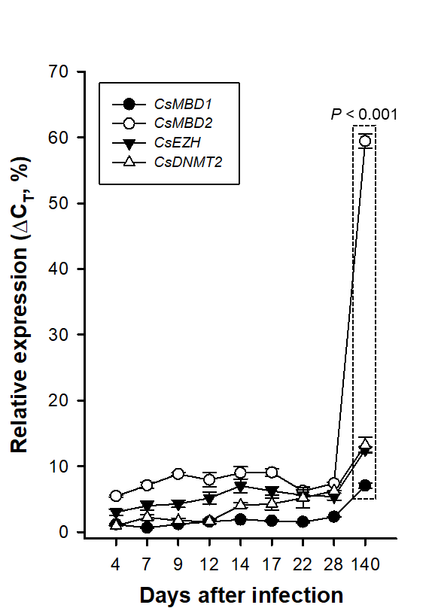
Supplementary Fig. S3. Temporal expressions of Clonorchis sinensis CsEZH (protein accession number GAA55462), CsMBD1 (GAA50068), CsMBD2 (GAA57483), and CsDNMT2 (GAA54195) genes. The gene expression profiles were examined by the quantitative reverse transcription PCR analysis of total RNAs, which were extracted from C. sinensis worms at different maturation stages from 4- to 140-day-old. The calculations are based on independent technical triplicates (n = 3, mean ± standard deviation). The statistical significance of the expression changes (P values of the Student’s t test) at the latest stage, compared to those of its direct previous stage, is indicated in the graph.

